Slide 1
Health Data EDA
Exploratory Data Analysis on Medical Appointments
Presented by: Gautam Narang
Date: September 12th, 2023

Slide 2
Agenda
1. Introduction
• Background
• Dataset Overview
2. Data Preprocessing
• Data Cleaning
3. Descriptive Statistics
• Overall Attendance Rate
• Gender Distribution
• Medical Conditions and Attendance

Slide 3
Agenda Cont’d
4. Conclusion and Recommendations
• Key Takeaways
• Predictive Factors Summary
• Recommendations for Improving Attendance
Chalenge 3

Slide 4
Introduction
Background
• Dataset: Appointment records for Brazilian public hospitals.
• Objective: Identify factors influencing patient attendance.
• Question: What factors predict patient attendance?
Dataset Overview
• Patients' attributes:
• Appointment information:
• Geographical

Slide 5
Data Preprocessing
Data Cleaning
• Removed duplicates, missing values, and outliers.
• Ensured data consistency and integrity.
Feature Engineering
• Created new features:
• Day of the week for appointments.
• Time between scheduling and appointment.
• Age groups.

Slide 6
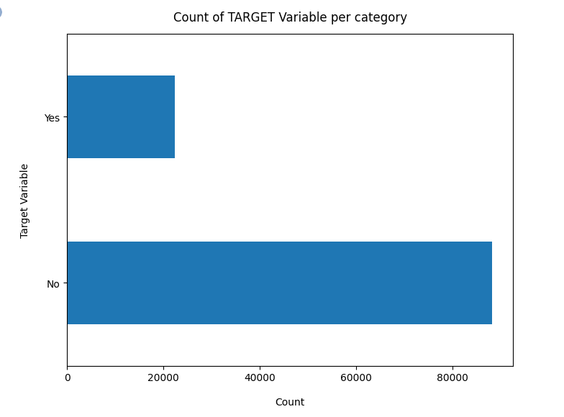
Descriptive Statistics

Slide 7
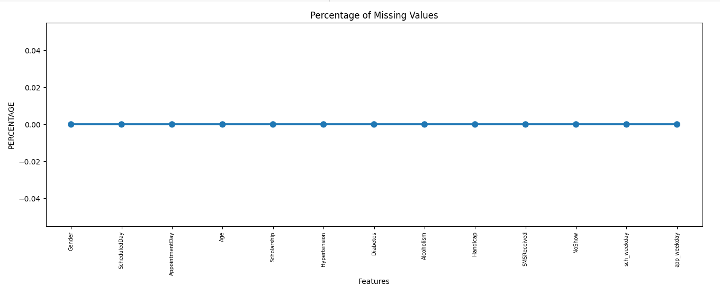

Slide 8
Missing Data - Initial Intuition
We don't have any missing data
General Thumb Rules
For features with less missing values - can use regression to predict the missing value to fill with the mean of the value present, depending on the feature.
For feature with very high number of missing values, it is better to drop those columns as they give very less insight on analysis.
As there is no thumb rule on what criteria do we delete the columns with high number of missing values,, if we have 30-40% of missing values.

Slide 9
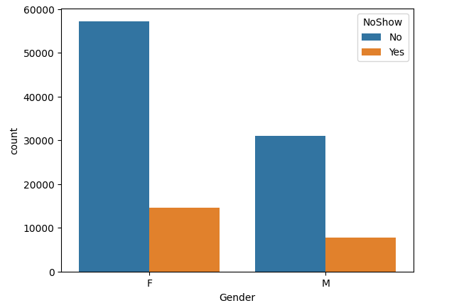
Analysing No Show Data for Medical Appointments

Slide 10
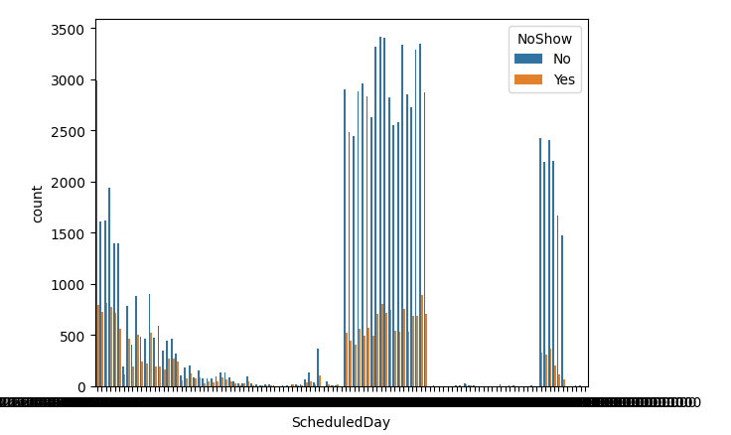

Slide 11
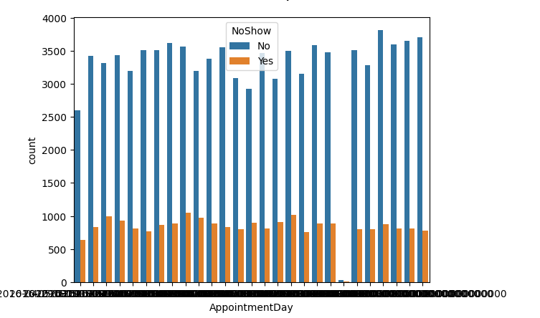

Slide 12
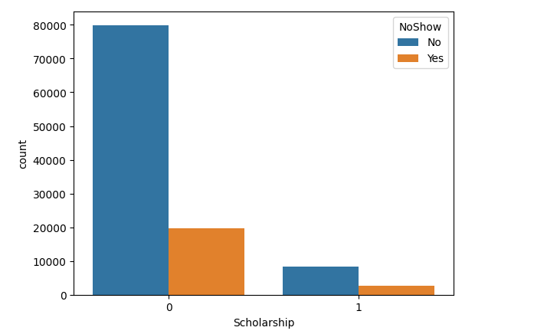

Slide 13
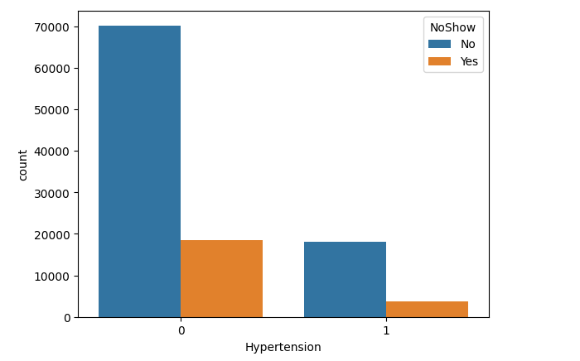

Slide 14
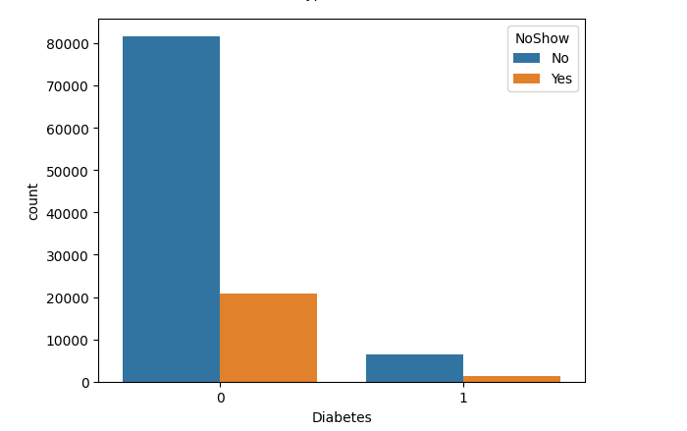

Slide 15
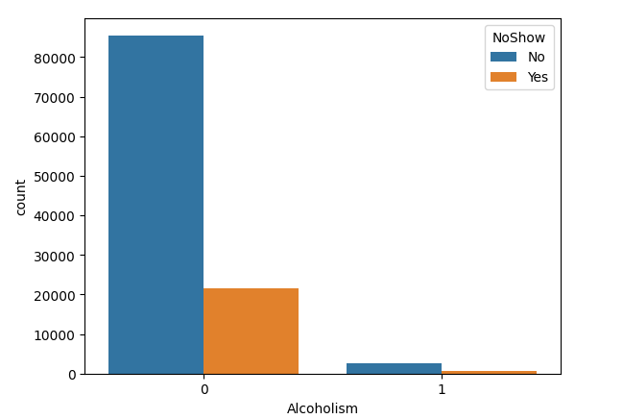

Slide 16
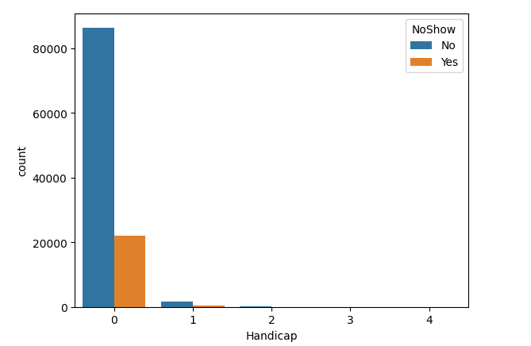

Slide 17
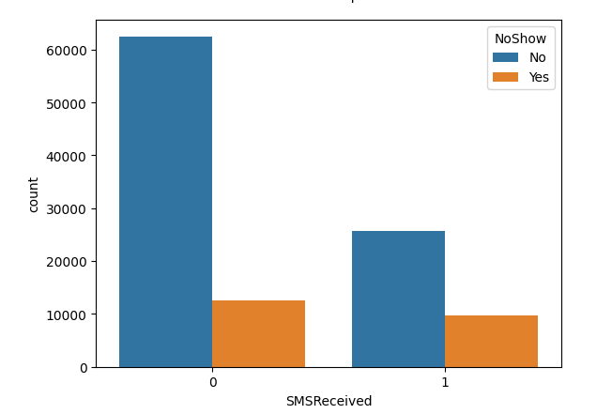

Slide 18
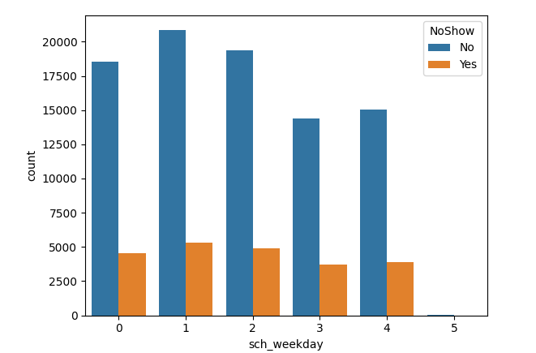

Slide 19
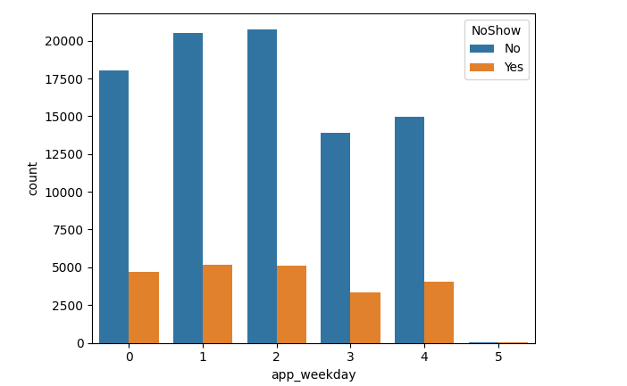

Slide 20
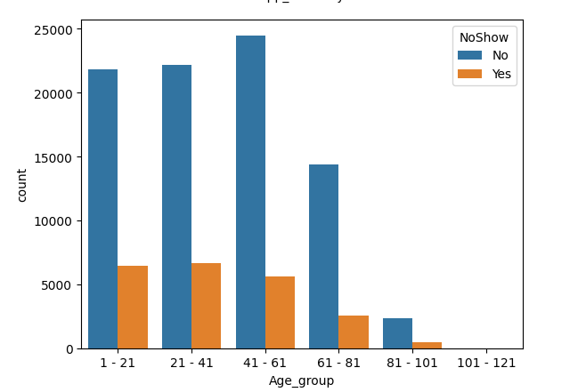

Slide 21
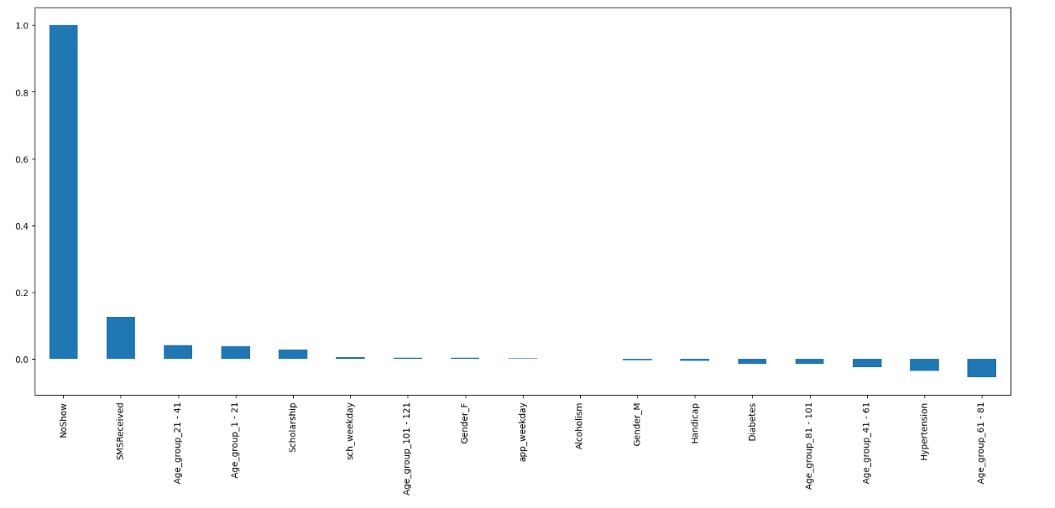
Finding Correlation of All Predictors with 'No Show'

Slide 22
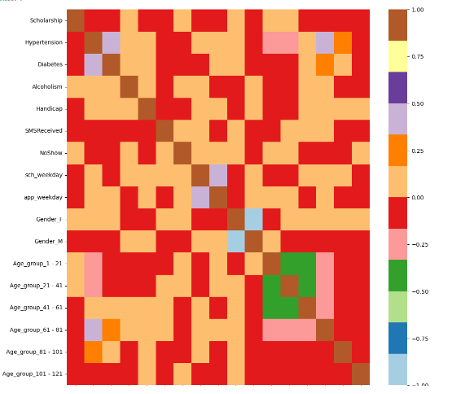
Heat Map showing Correlation with 'No Show'

Slide 23
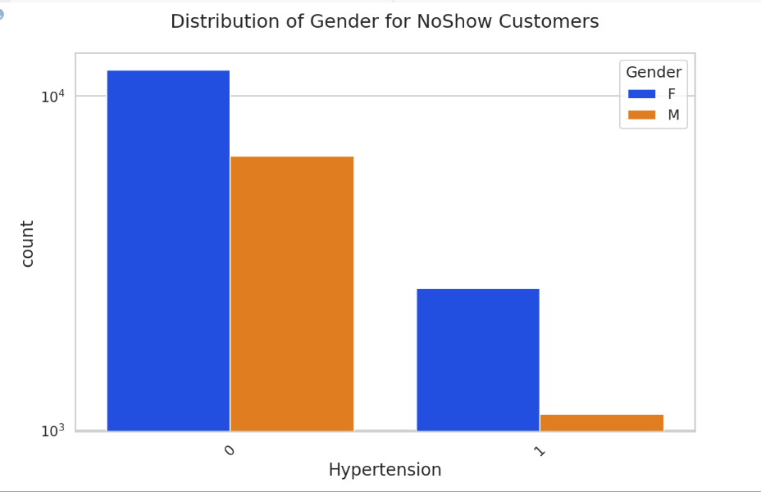
Bivariate Analysis

Slide 24
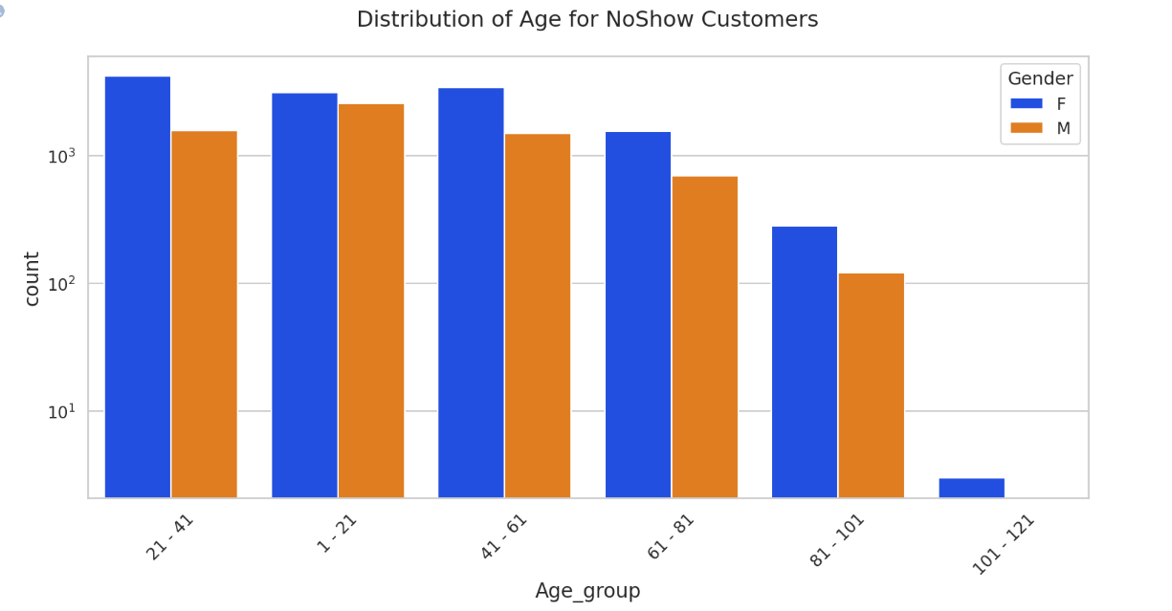

Slide 25
Conclusion
Female patients have taken more appointments than male patients.
Ratio of no show and show is almost equal for age group except Age 0 and Age 1 with 80% show rate for each age group.
Each Neighbourhood has almost 80% show rate.
There are 99666 patients without scholarship and out of them around 80% have come for the visit and out of the 21801 patients with scholarship around 75% of them have come for the visit.
There are around 88,726 patients without hypertension and out of them around 78% have come for the visit and out of the 21801 patients with hypertension around 85% of them have come for the visit.

Slide 26
Conclusion Cont’d
There are around 102,584 patients without Diabetes and out of them around 80% have come for the visit and out of the 7,943 patients with Diabetes around 83% of them have come for the visit.
There are around 75,045 patients who have not received SMS and out of them around 84% have come for the visit and out of the 35,482 patients who have received SMS around 72% of them have come for the visit.
There are no appointments on sunday and on saturday appointments are very less in comparison to other week days.

